Slide 1

Augmented & Virtual Reality: Redefining Indoor Navigation
Transforming how we experience and navigate the built environment

Slide 2
Beyond the Map: Immersive Experiences
Contextual Awareness
Interactive Environments
Real-time updates, directions, and points of interest
Engage with digital elements, explore virtual exhibitions

Slide 3
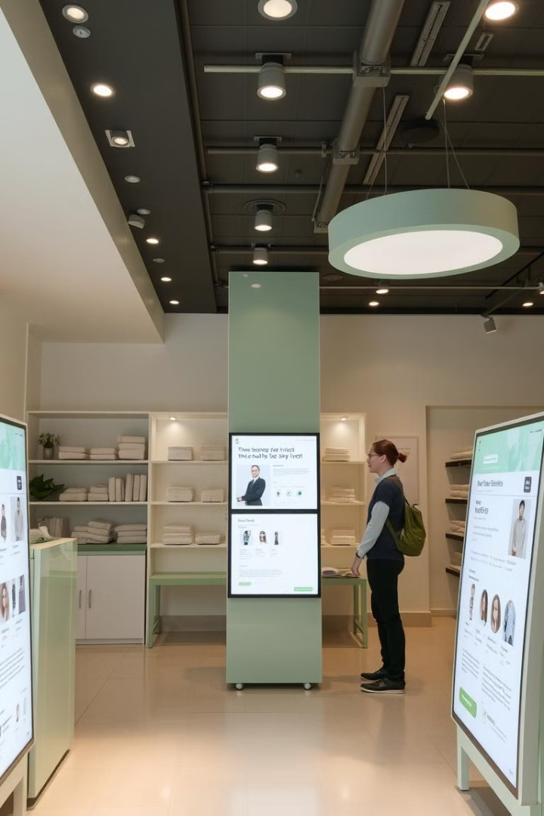



AR/VR in Retail: Elevating the Shopping Journey
Personalized Recommendations
Virtual Try-Ons
Experience products before purchasing, virtually try on clothes
Discover tailored products based on preferences
Interactive Product Displays
Explore product details, view 360° views, and engage with demos

Slide 4
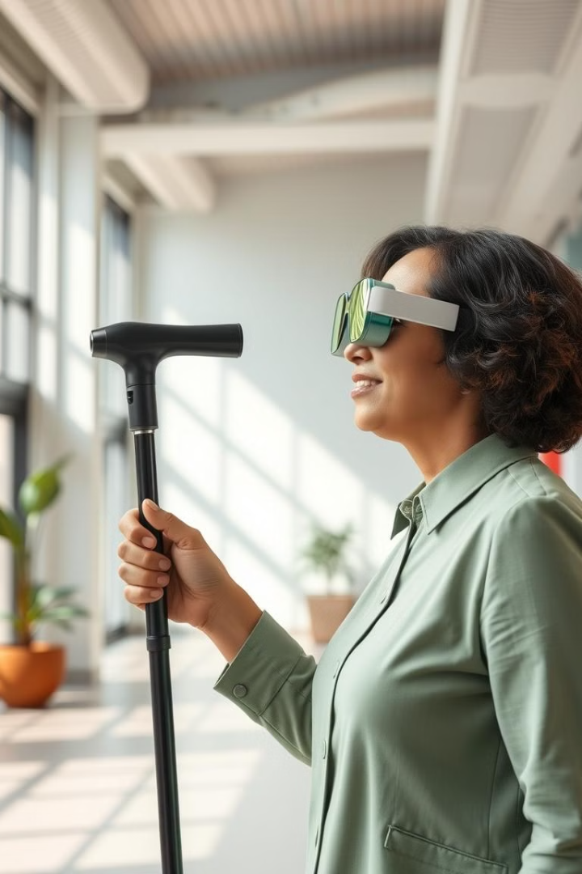
Accessibility & Inclusivity
1
Enhanced Navigation
2
Personalized Guidance
Real-time audio cues and tactile feedback
Adaptive navigation based on user needs and preferences
3
Inclusive Environments
Breaking down barriers for people with disabilities

Slide 5




AR/VR in Healthcare: Transforming Patient Experiences
1
Pain Management
2
Mental Health
3
Rehabilitation
4
Medical Training

Slide 6
Smart Cities: Enhancing Urban Environments
1
Traffic Optimization
2
Sustainable Development
3
Citizen Engagement
4
Emergency Response

Slide 7
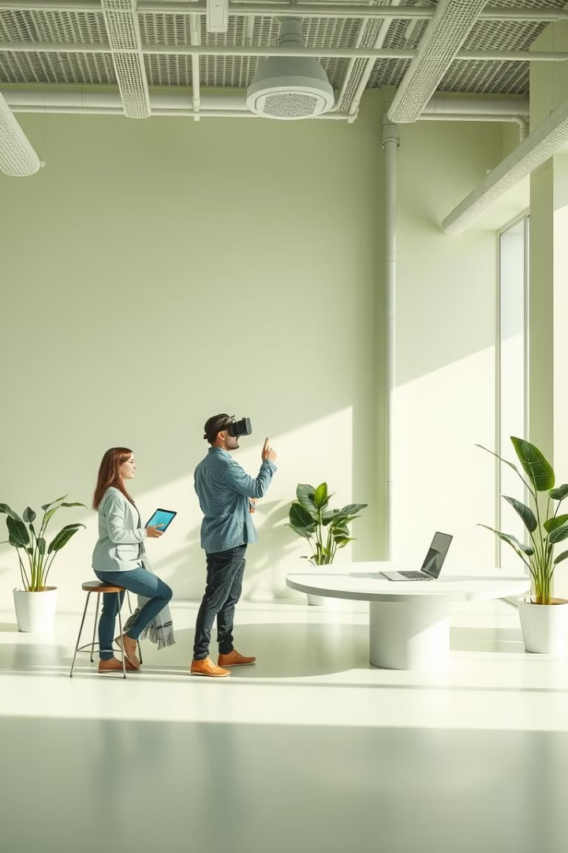



The Future of Indoor Navigation
Personalized & Adaptive Navigation
Seamless Integration with Smart Devices
Enhanced Safety & Security

